Slide 1
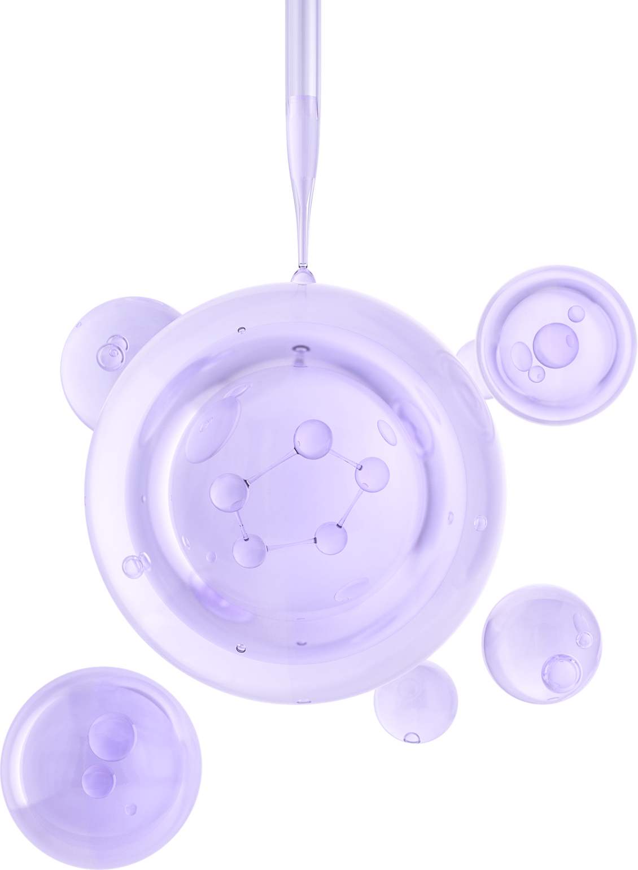

RAFAELLA P. DE ANDRADE
ID: 30648324
BREAST CANCER CLASSIFICATION
Feature Selection and Model Evaluation

Slide 2
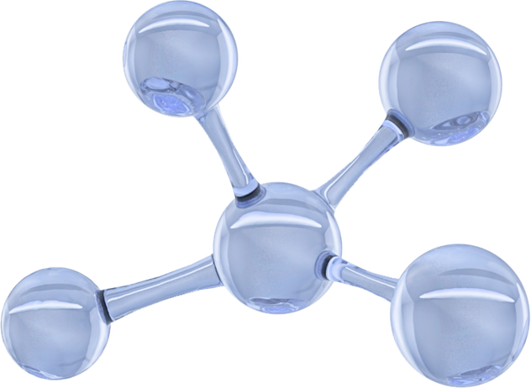
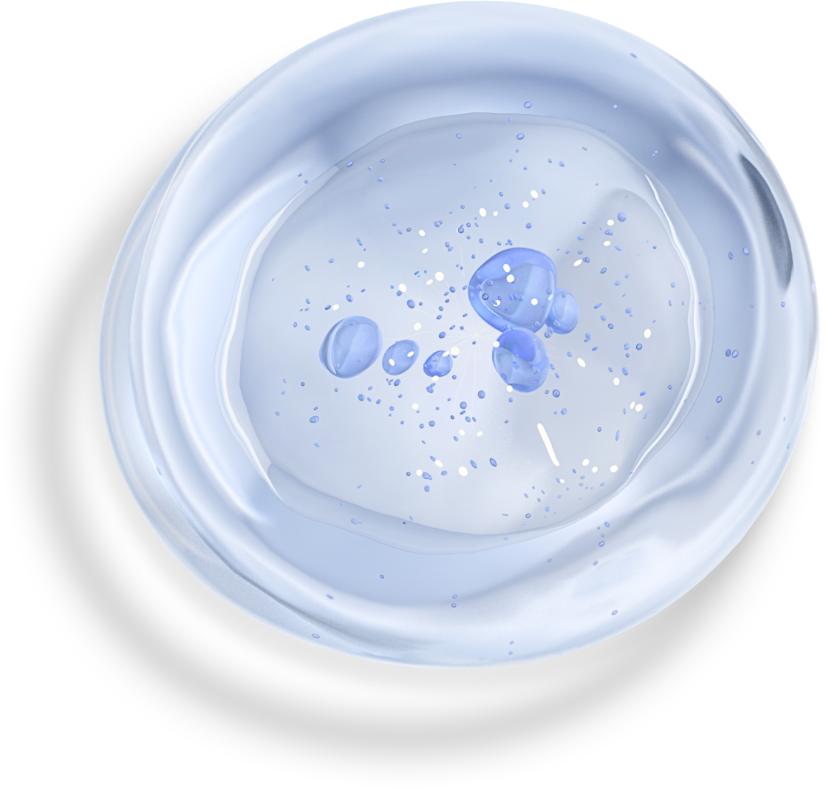
Introduction
Accurate breast cancer classification is pivotal in healthcare, shaping diagnostic and treatment strategies. Precision in classification enables tailored treatments and improving overall healthcare quality. Early and precise identification of tumor characteristics is crucial for proactive care, ultimately enhancing patient well-being and survival rates.

Slide 3
Breast Cancer Data set
FEATURES
CHALLENGES
Representing Tumor’s Characteristics
30 Features
A large number of features can result in some challenges such as:
Mean radius
Mean texture
Mean perimeter
Mean area
Mean smoothness
Mean compactness
Mean concavity
Mean concave points
Mean symmetry
Mean fractal dimension
Radius error
Texture error
Perimeter error
Area error
Smoothness error
Compactness error
Concavity error
Concave points error
Symmetry error
Fractal dimension error
Worst radius
Worst texture
Worst perimeter
Worst area
Worst smoothness
Worst compactness
Worst concavity
Worst concave points
Worst symmetry
Worst fractal dimension
Curse of Dimensionality: As we increase the number of features in the data set, the number of rows will also increase. Consequently there is an increase in the exigence of money, time and computational power
Overfitting: Poor generalization, the model only predicts accurately the data which it’s trained to predict.
Redundancy: Some features may convey similar information, leading to strong correspondence between them which is not really meaningful.

Slide 4
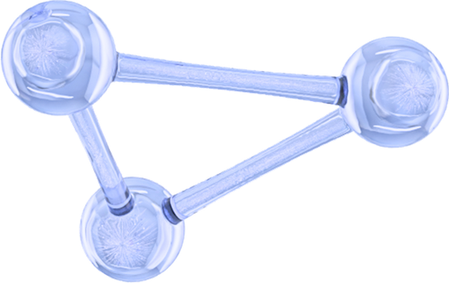
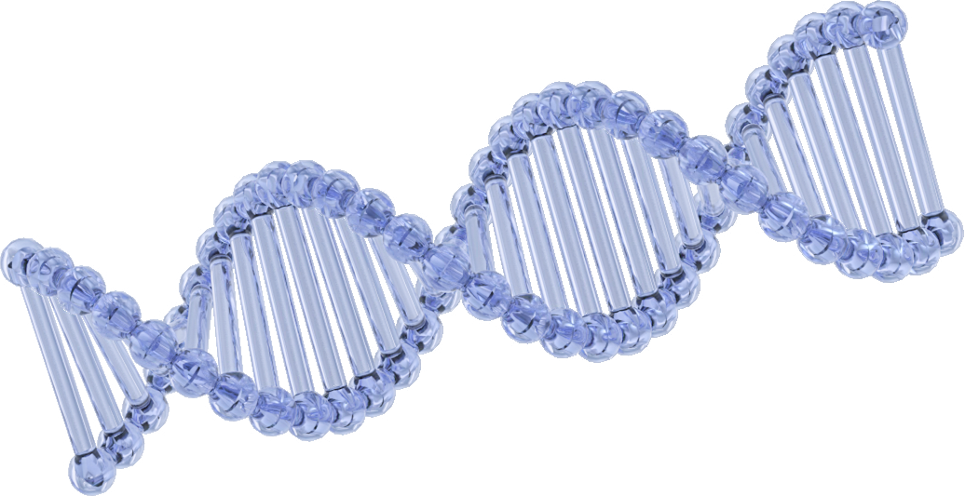
Feature Selection Techniques
With the aim of overcoming the challenges that a great number of features can bring, feature selection techniques were employed, such as:
KBest;
LASSO;
Decision Trees;

Slide 5

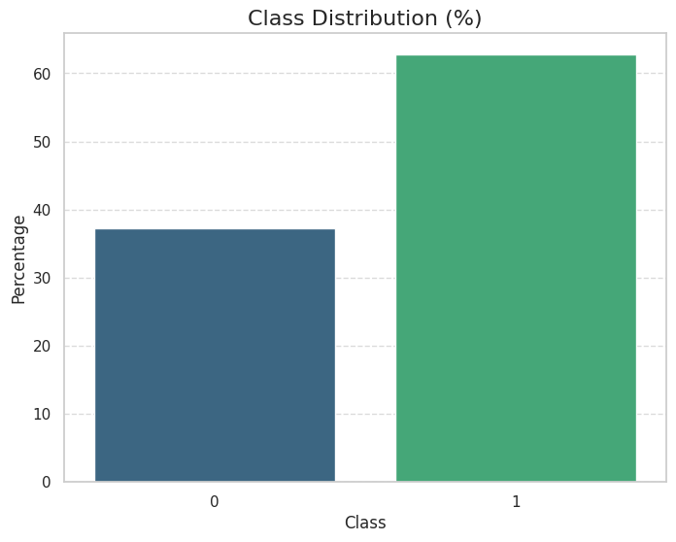
EDA (Exploratory Data Analysis)
No null values.
All the variables were of the correct data type, disregarding the target, that required an adjustment from interger to category.
Target:
-2 categories. The target, which is the result from breast cancer exams, could either be Malignant or Benign.
Malignant = 0
Benign = 1
- 37.26% of the results were for Malignant tumors.
- 62.74% of the results were for Bening tumors.

Slide 6
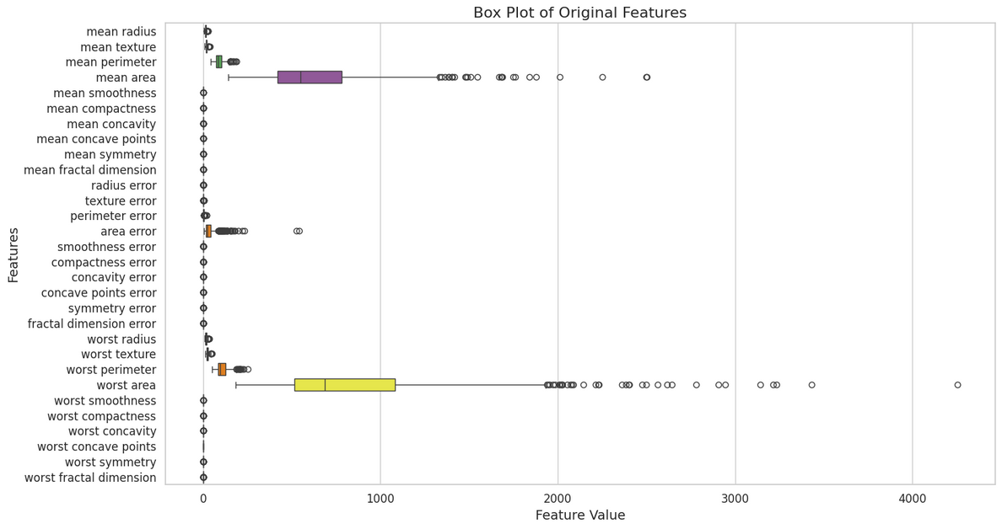
EDA (Exploratory Data Analysis)
Standardization: There were many features with different unit measurements. This could cause misinterpretation by distoring the graphs. Therefor, the data was all standardize with the goal of giving all the features equal importance.

Slide 7
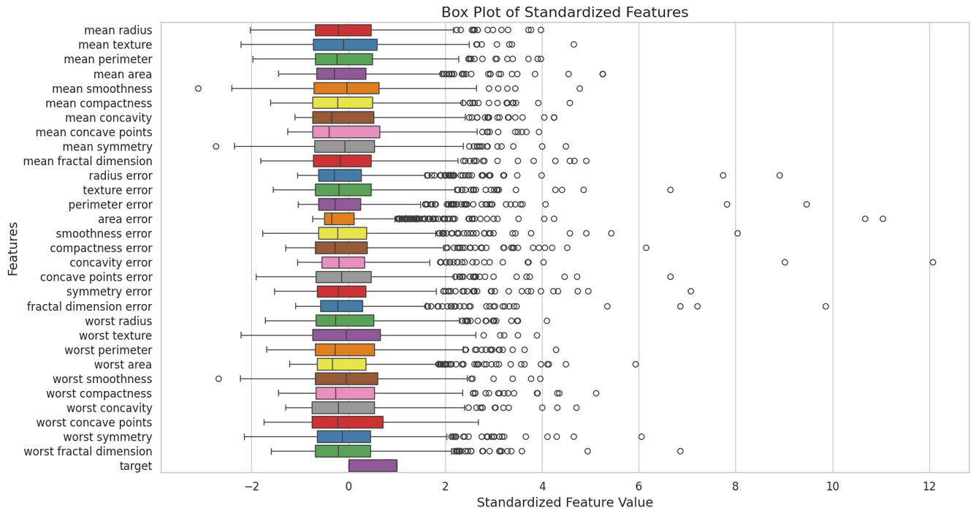
EDA (Exploratory Data Analysis)
Box plots after standardization:

Slide 8
EDA (Exploratory Data Analysis)
Outliers: Some outliers were removed, respecting the limit of removing up to 5% of all the rows. A regression was ran on the new data frame df_no_outliers and the accuracy score actually improved. Which supported the decison to keep working with the new data frame.

Slide 9
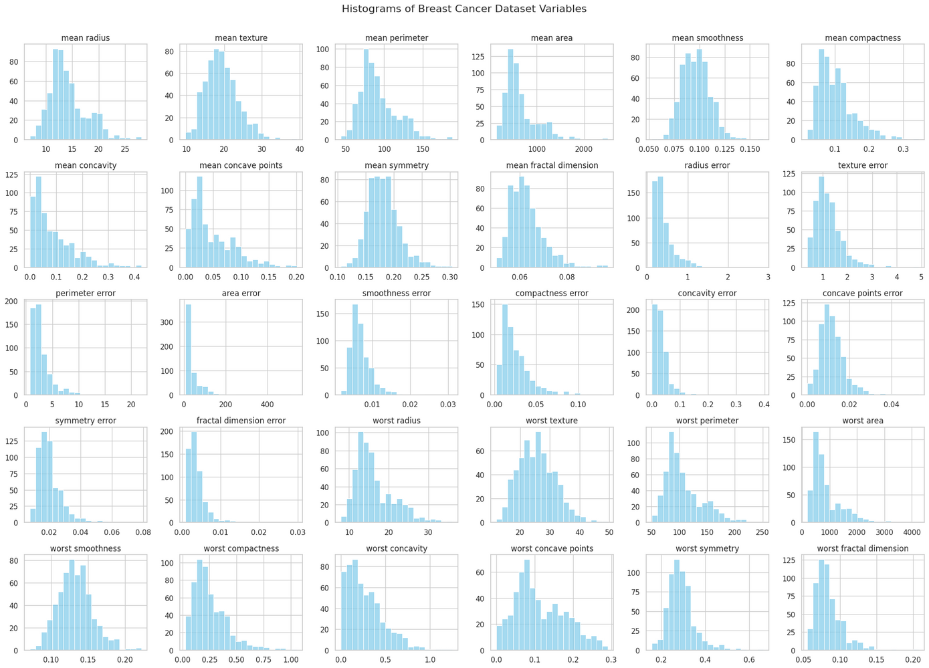
EDA: Univariate Analysis
Histograms of features
To analyze the behaviors of the data points of each feature, histograms were created. Almost all variables present a left skewed distribution. Mean Smoothness and Worst Smoothness are the closest ones to a normal distribution.

Slide 10
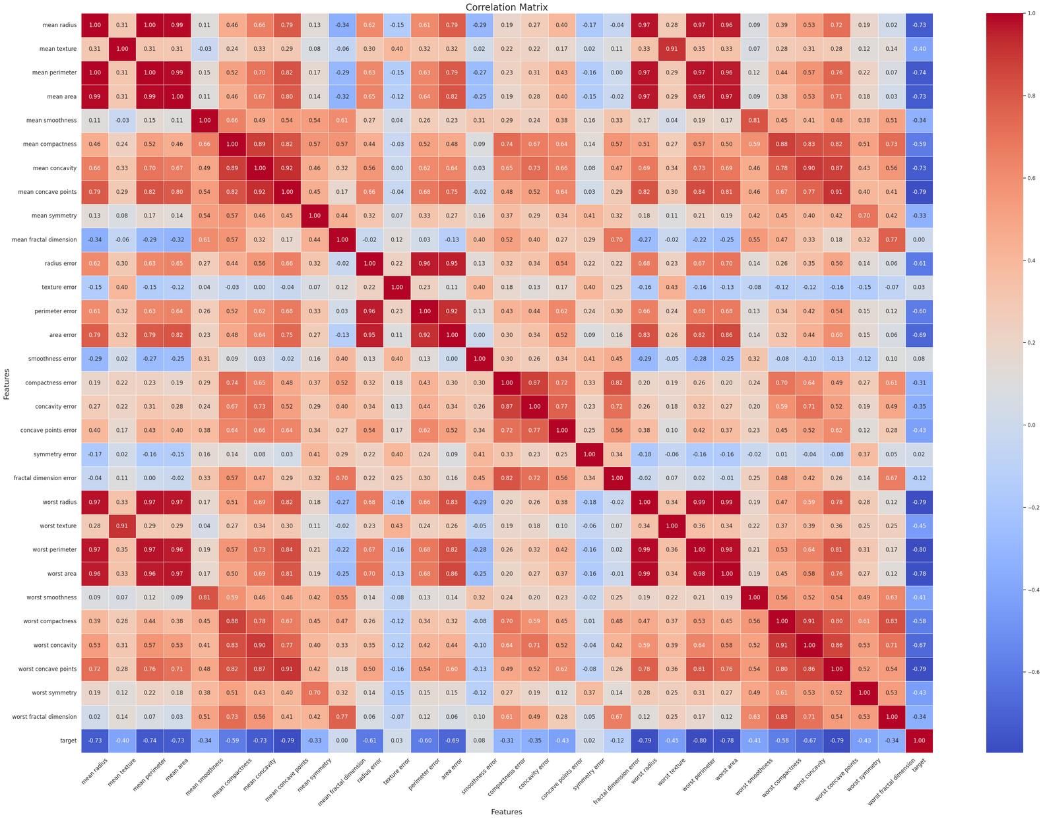
EDA: Bivariate Analysis
Correlation Matrix
Used .sort_values and .index.get_level_values
to get the 10 strongest correlations from the correlation matrix.
Mean Radius and mean perimeter: 1.00
Worst perimeter and worst radius: 0.99
Mean area and mean radius: 0.99
Worst radius and worst area: 0.99
Mean perimeter and mean area: 0.99
Worst area and worst perimeter: 0.98
Worst radius and mean perimeter: 0.97
Worst perimeter and mean perimeter: 0.97
Worst radius and mean radius: 0.97
Worst radius and mean area: 0.97
Extremely high correlation coefficients. From 0.7 the correlation coefficient is already considered high. These start at 0.99.

Slide 11
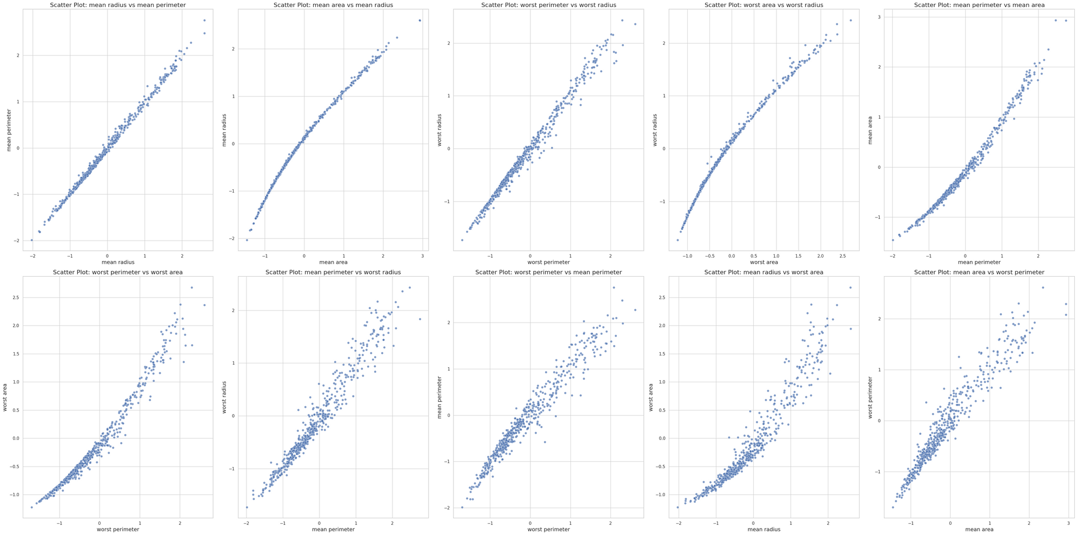
EDA: Bivariate Analysis
Scatter Plots
Scatter plots were created for the ten most strongly correlated features in order to observe their relationship. All of them are positively correlated.

Slide 12
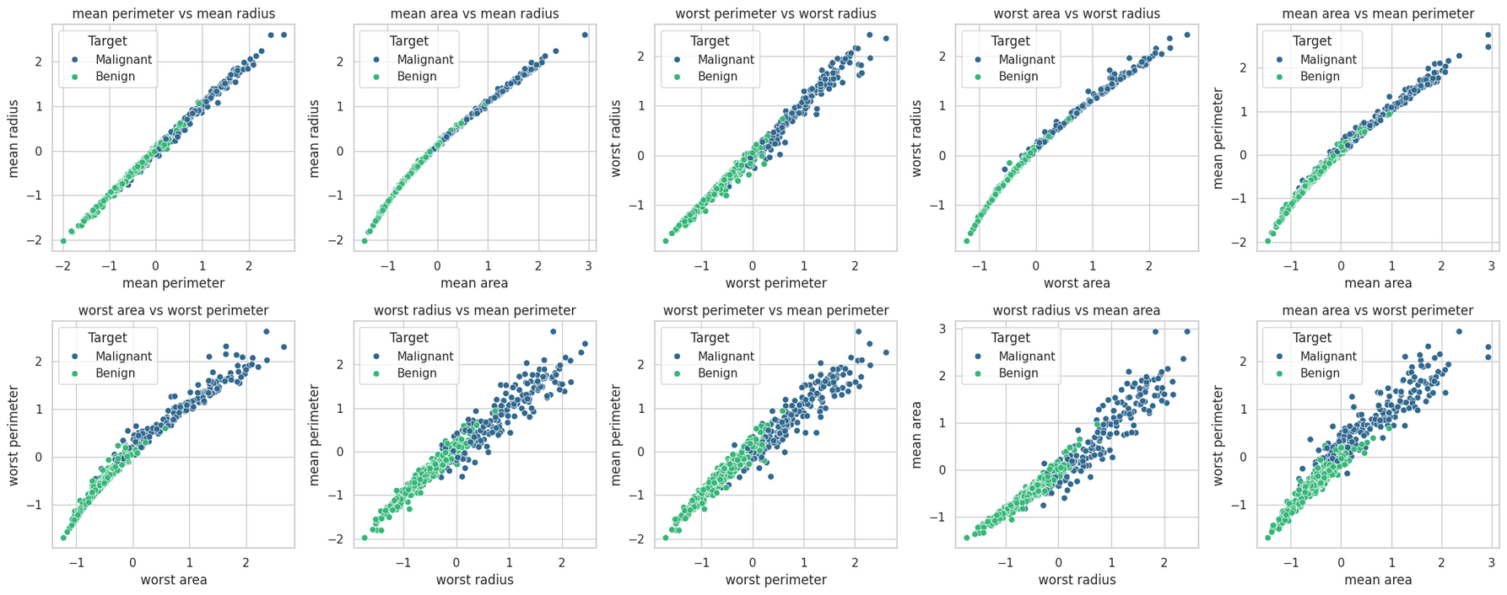
EDA: Multivariate Analysis
Scatter Plots
Scatter plots colored by the target variable were created seeking any pattern in the distributions. Despite some mixed data points around the middle of the distributions, generally, the Benign Tumor clusters are on the areas with lower measurements. And as the size increase, the results often change for Malignant Tumors.

Slide 13

Common Points in all the Feature Selection methods.
Feature Selection
KBest
Decision Tree
LASSO
KBest was ran in order to get the features considered the most relevat ones in the dataset (through an assesment on their score in the chi2 test.
Running LASSO to identify the most relevant features by selecting features with non-zero coefficients.
Applying the decision tree method to identify key features for predicting the target variable through a tree model.
K = 10
Chosen through experimentation.
Alpha = 0.01
Mean Radius
Mean Perimeter
Mean Area
Mean Concavity
Mean Concave Points
Area Error
Worst Radius
Worst Perimeter
Worst Area
Worst Concave Points
Mean Concave Points
Mean Fractal Dimension
Radius Error
Smoothness Error
Compactness Error
Worst Radius
Worst Texture
Worst Smoothness
Worst Concavity
Worst Concave Points
Worst Symmetry
Mean Concave Points
Radius Error
Area Error
Compactness Error
Worst Radius
Worst Texture
Worst Perimeter
Worst Area
Worst Concavity
Worst Concave Points

Slide 14

Best Performance
Accuracy Score & F1 Scores:
Baseline Model:- Accuracy: 0.956140
F1 Score: 0.95263
KBest Model:
Accuracy: 0.944444
F1 Score: 0.940441
LASSO Model:
Accuracy: 0.972222
F1 Score: 0.970064
Combined Model: Accuracy: 0.972222
F1 Score: 0.970064
Decision Tree Model: Accuracy: 0.962963
F1 Score: 0.970149
LASSO & DT Model: Accuracy: 0.962963
F1 Score: 0.960294
Best Performance: LASSO

Slide 15
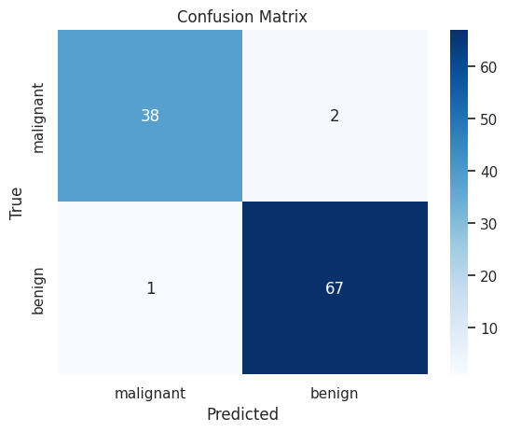
LASSO Model Confusion Matrix
The confusion matrix from the model with the best performance (With features selected with the LASSO method) shows that even with improvements, it still presents 2 false malignant results and 1 false benign result.
That model wouldn't be suitable for cases in which you need zero error margin.

